Slide 1

CREDIT CARD FRAUD DETECTION
Leveraging Data Science to Combat Financial Fraud
Laura Le – Data Scientist

Slide 2
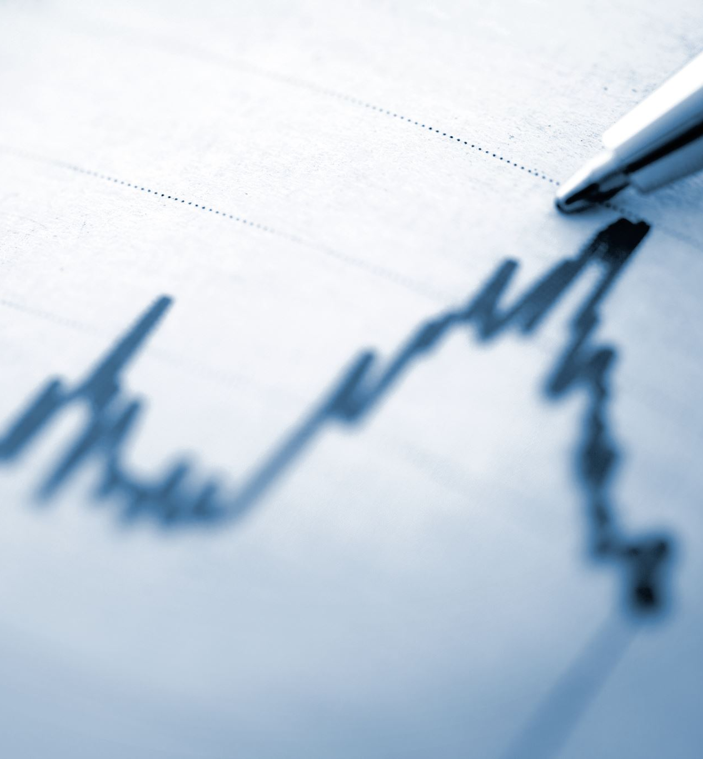
Business Context
Problem: Fraud issue impact on consumers and business:
Consumer reports show a loss of $8.8 billion to fraud in 2022.
26% of US adults have been affected by credit card fraud.
Direct financial losses exceed $180MM annually.
Objective: develop a system that not only detects but also predicts and prevents potential fraud to save millions by proactively identifying risks.
Data Science Opportunity: Utilizing transactional data and customer behavior from 2000 customers from 2016 to 2019 to uncover hidden patterns indicative of fraud.
Notes:
Hi everyone, about the business context, Recent reports reveal $8.8 billion lost to fraud in 2022 alone, affecting one in four American adults. Beyond the $180 million annual financial loss, fraud's broader impact includes damage to trust, increased security costs, and harm to brand reputation.
The objective of this project is to create a system to detect, predict, and prevent fraud, by leverage a rich dataset of 2,000 customers over three years, seeking hidden patterns indicative of fraudulent activity.
In essence, we're turning data into a defense mechanism, using analytics to build a robust barrier against financial crime. Now, let's delve into our approach and discoveries in addressing this challenge.

Slide 3
Data Cleaning
Pruned Features: Dropped non-informative attributes
Normalized Currency Data: Cleaned currency symbols from financial figures
Enhanced Time Features: Extracted specific time components for in-depth temporal analysis
Format transform: Transformed 'Fraud' indicator to a binary format
Missing Value Imputation: Filled in 'Errors' column blanks with a default 'No errors'
Notes:
First steps is cleaning data to ensure the quality and integrity of our analysis.
Firstly, I remove any non-informative attributes, focusing only on the data essential for fraud detection.
Next, cleaning out currency symbols to streamline financial figures for computational purposes.
To enhance the time features, I extract specific components like hour, minute, day of week to uncover patterns related to the timing of fraudulent activities.
For the target variable, I transformed the 'Fraud' indicator into a binary format.
Lastly, I addressed missing values in the 'Errors' column by imputing them with a default 'No errors' entry.

Slide 4
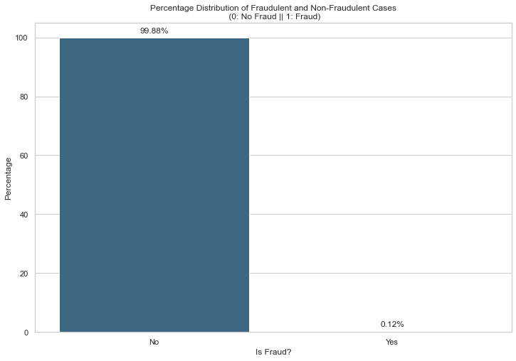
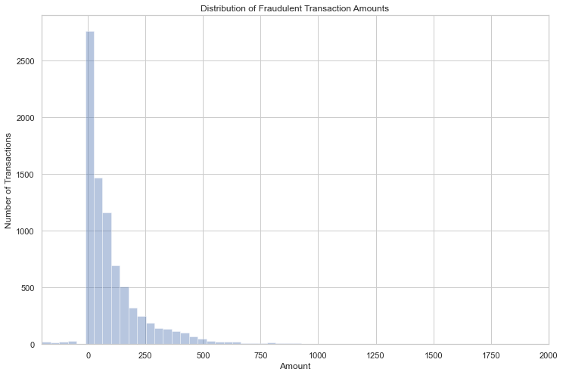
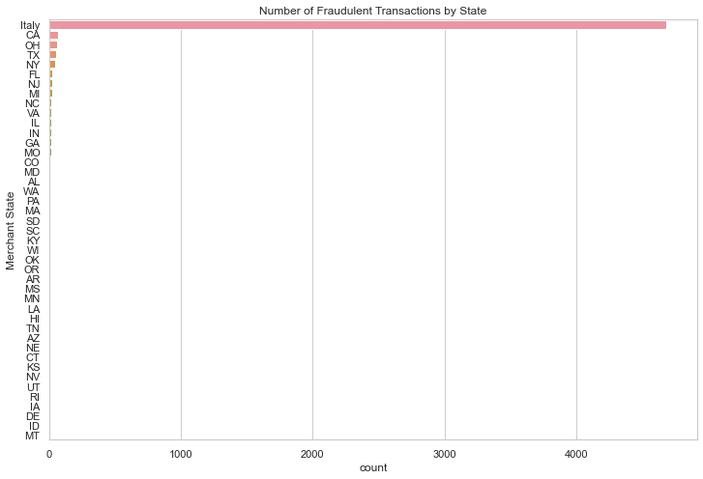
Data Exploration
Data Imbalance
  Non-Fraud: 99.87%, Fraud: 0.12%
Transaction Amounts
  Fraud prevalent in $0 - $250 range
Geographic Distribution
  Beside Italy, US states: CA, OH, TX, NY record highest fraud incidences.
Notes:
As we look at this "Data Exploration" slide, we can see that:
Firstly, we have a significant data imbalance with only 0.12% of transactions being fraudulent.
Secondly, the fraud amount is mostly under $250, indicating that smaller transactions are often targeted.
Lastly, The distribution of fraud cases shows clear geographical differences. Italy emerges as a major fraudulent activity hotspot at the country level. Among US states, California, Ohio, Texas, and New York records the highest incidences of fraud

Slide 5
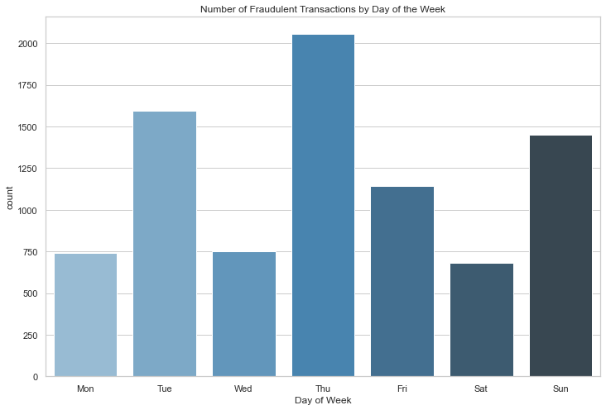
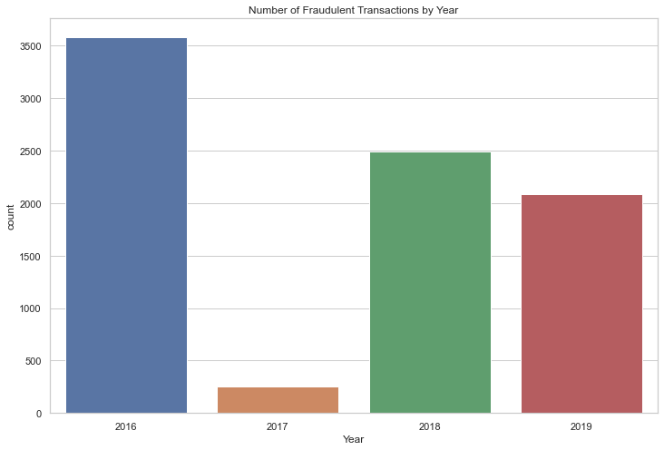
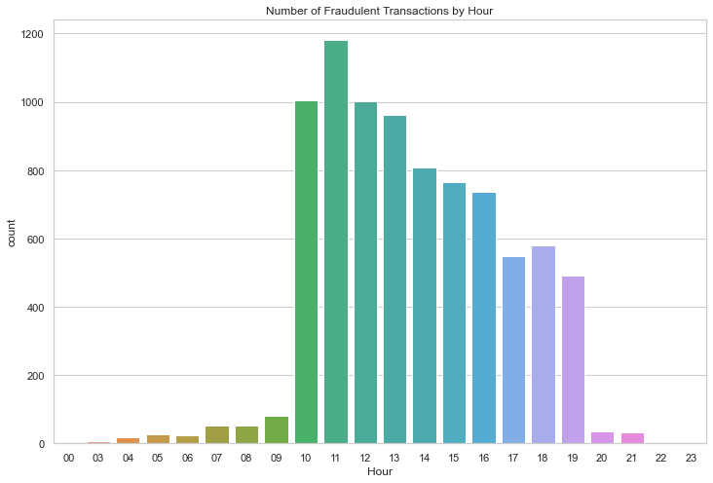
Data Exploration
Annual Trends
  2016 peak, 2017 drop, post-2017 moderate
Weekly Patterns
  High: Thursdays, Low: Weekends
Daily Activity
  Peak: 10 AM - 12 PM, Trough: 12 AM - 7 AM
Notes:
We observed that the distribution of fraud cases displays time variations. For annual trend, there is a significant peak in fraudulent activity in 2016, a decrease in 2017, and a moderate rise post-2017.
Weekly patterns reveal that fraud peaks on Thursdays and dips during the weekends.
Lastly, the risk of fraud is highest between 10 AM and 12 PM, and it drops significantly from midnight to 7 AM.

Slide 6
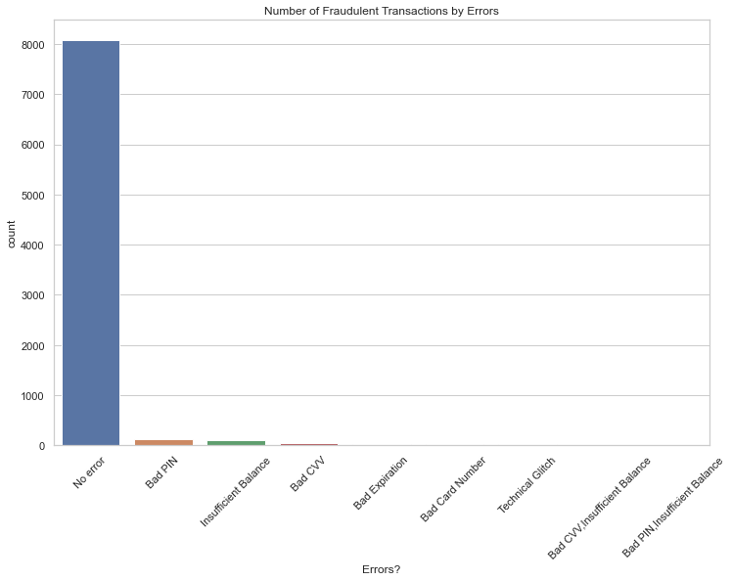
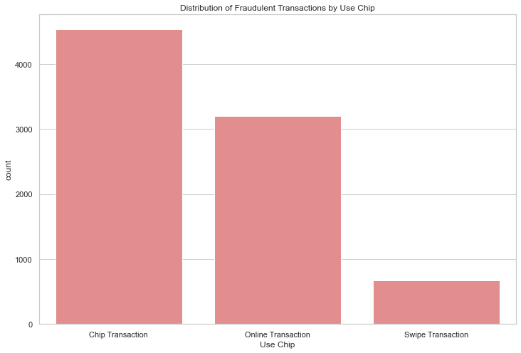
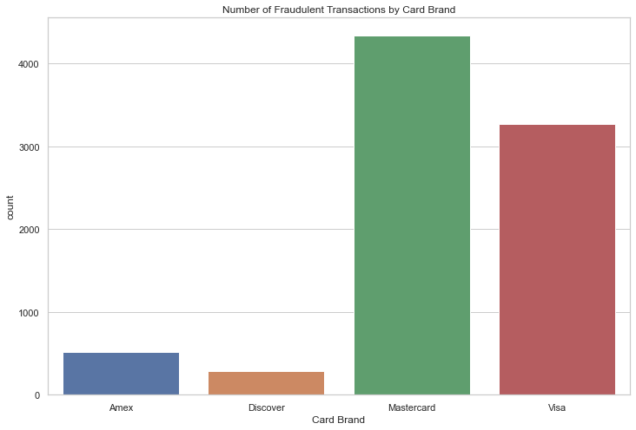
Data Exploration
Transaction Type & Fraud
  Chip transactions lead in fraud, challenging their perceived security.
Error Transactions
  Most fraud occurs with 'No error' flagged, undermining common error-based detection.
Card Brand Vulnerability
  Mastercard and Visa top in fraud incidents, Amex and Discover less so.
Notes:
We notice chip transactions, which are typically have high security, are leading in fraud activities, followed by online and swipe transactions.
Next, The data tells us that most fraud transactions occur without any errors being flagged at all. Traditional error signals like 'Bad PIN' or 'Insufficient Balance' are rare, indicating that fraudsters have found ways to overcome standard error checks.
Lastly, we observe that Mastercard experiences the highest frequency of fraud transactions, with Visa close behind, while Amex and Discover are targeted less frequently.

Slide 7
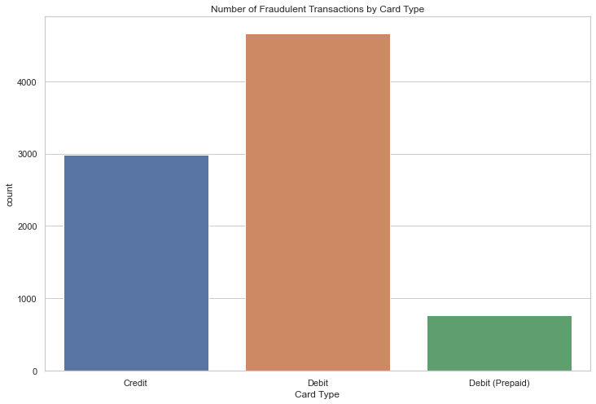
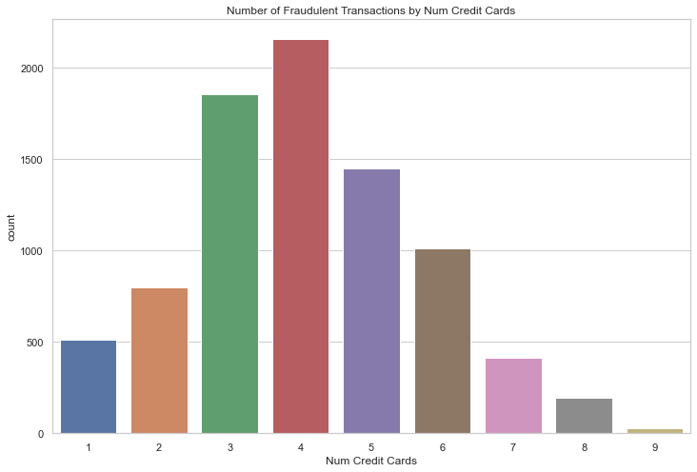
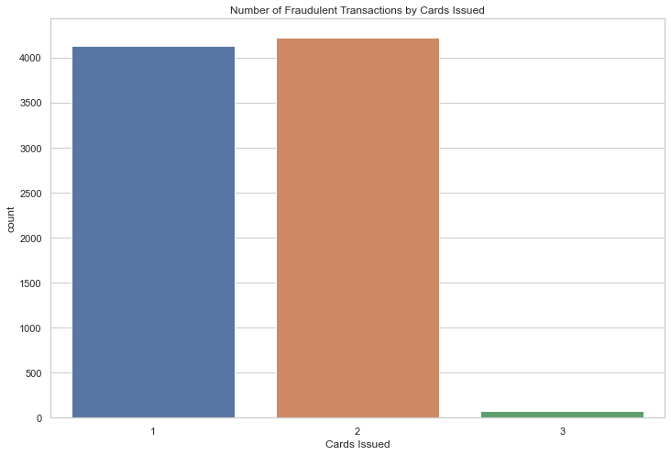
Data Exploration
Card Type & Fraud
  Highest fraud in Debit cards, least in Prepaid Debit
Cards Issued & Fraud Incidence
  Most fraud in accounts with 1-2 cards, less with 3 cards
Credit Cards Held & Risk
  Fraud peaks with 3-4 cards, drops with more or fewer cards
Notes:
On this slide, we observe that debit cards are the most frequently used in fraudulent transactions, much more than credit cards, when prepaid debit cards showing the lowest incidence of fraud.
Next, Fraud is most common in accounts with just one or two cards issued. Accounts with three cards issued see a significantly lower number of fraud cases.
Lastly, when we look at the number of credit cards held by individuals, there's a peak in fraud cases for those with three to four cards, while a lower risk of fraud is associated with holding either more or fewer cards.

Slide 8
Data Preprocessing
Features Selection
Identified key variables impacting fraud likelihood based on Exploratory Data Analysis (EDA)
Preprocessing Pipeline
- Hour conversion, Amount scaling, Error flagging.
- Binary encoding for 'Use Chip' and 'Day of Week'.
- Label encoding for 'Card Brand', 'Card Type', 'Merchant City', 'Merchant State’.
Under Sampling
Implemented Random Under Sampling on a 40,000 subset with 20% fraud cases to balance data and optimize model performance given computational constraints.
Notes:
Now I’m focusing on the crucial steps of data preprocessing that lay the groundwork for the predictive modeling.
begin with feature selection, where I’ve pinpointed the variables that significantly influence the likelihood of fraud that revealed by the exploratory data analysis.
Next, I constructed a pipeline tailored to optimize these features for the modeling process. This includes converting the feature to the correct format, scaling the feature for normalization. Additionally, I applied binary encoding and label encoding to categorical features.
Lastly, to address the imbalance in dataset, I implemented Random Under Sampling on a subset of 40,000 data points, ensuring that 20% of them are fraud cases. This approach not only balances the data but also fits within the computational limits, paving the way for a more accurate and efficient model.

Slide 9
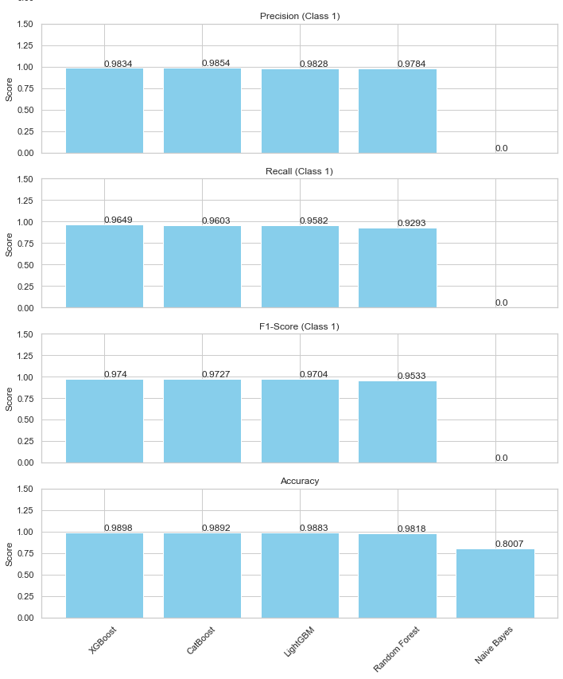
Predictive Modeling
Algorithms Tested
  Compared different algorithms to find the best at catching fraud: LightGBM, XGBoost, Naive Bayes, CatBoost, Random Forest
Top Fraud Detectors
  XGBoost: Excellent at flagging suspicious transactions with top-notch accuracy (99% success rate)
  CatBoost: Exceptional at pinpointing the exact transactions that are fraudulent (99% success rate)
Fine-tunning adjustment and Cross-Validation Scores
  XGBoost scored 98.77% effectiveness
  CatBoost slightly better at 98.80%
Recommendation
  CatBoost showed it could be the best option for catching fraud
Notes:
this slide highlight the journey in training fraud detection models
I tested different algorithms to identify the most effective at uncovering fraudulent activities., including LightGBM, XGBoost, Naive Bayes, CatBoost, and Random Forest.
The evaluation reveals that XGBoost stands out for its exceptional ability to flag suspicious transactions accurately, while CatBoost excels in precisely identifying fraudulent transactions.
They all have 99% accuracy rate. Then I made fine-tuning adjustments for both of them to compare which one have better performance,
Given the result of cross-validation, CatBoost score 98.80% effectiveness, making it slightly better. Therefore, It is our best option for further refinement and deployment in catching fraud

Slide 10
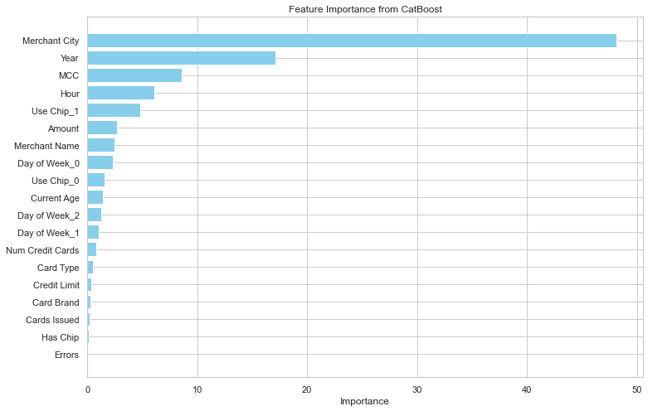
Insight & Recommendations
Key predictors of Frauds:
Merchant Location: Fraud trends linked to merchant cities.
Transaction Year: Fraud patterns changing over time.
Merchant Category: Type of merchant associated with fraud risk.
Transaction Hour: Certain hours more susceptible to fraud.
Online Transactions: Online payments more high risk to fraud.
Transaction Amount: Unusually high or low amounts compared to a user's typical transaction patterns can be red flags.
Recommendation
City-Level Focus: Intensify monitoring in cities with prevalent fraud.
Yearly Fraud Pattern Analysis: Analyze transaction data annually to anticipate and prepare for fraud surges.
Merchant Category Monitoring: Elevate monitoring on transactions within high-risk merchant categories
Hourly Fraud Alertness: Implement enhanced real-time monitoring during peak hours for fraud.
Online Transaction Security: Strengthen security protocols and user education for online transactions.
Transaction Monitoring: Alert customers to transactions that are unusual for their spending habits.
Notes:
On this "Insight & Recommendations" slide, we discuss crucial findings into practical steps.
I've identified 'Merchant Location' and 'Transaction Year' as top fraud predictors, guiding us to focus on geographic and temporal fraud patterns.
'Merchant Category', 'Transaction Hour', and 'Online Transactions' also provide key insights, indicating the need for targeted monitoring and robust online security.
The action plan includes ramping up city-level fraud detection, analyzing annual trends, enhancing checks during high-risk hours, and reinforcing online transaction safety.
By alerting customers to unusual spending and adapting our defenses to these insights, we'll bolster our fight against credit card fraud.

